Slide 1


Occupational Therapy Assessment
If you have concerns about managing Activities of Daily living (ADL's) following your surgery, such as your ability:
to wash and dress
manage in/out of bed
manage on/off your chair and toilet
to transfer meals
You can ask to be seen by an Occupational Therapist in the ward who can discuss any concerns you have.
KNEE
Notes:
Following your surgery and initial recovery, activities of daily living should become easier. You may need to alter how you do things temporarily and ask for help from family/friends for certain tasks.

Slide 2
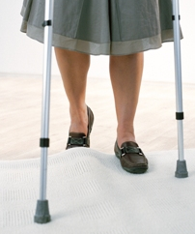
Prepare your home
Remove loose rugs and mats
Clear away cords and clutter that might trip you
Ensure clear pathways around your home
Move regularly used items from low heights
Have a lamp by your bed
Use a non-slip mat when showering.
Image © Biomet UK Ltd.
KNEE
Notes:
Following surgery you will be walking with 2 sticks or elbow crutches. It is important to avoid hazards in the home which could cause you to slip or trip causing a fall. If you live alone you may need to arrange help for certain tasks such as shopping , looking after a pet, and cleaning.

Slide 3
Sitting/rising
Seating :Try to use a firm chair with armrests.
Toilet: Toilet equipment is not routinely provided.
Bed: You may find it easier to get into bed with your unoperated leg first.
KNEE
Notes:
If your chair is very low, try placing a cushion or firm piece of foam on to it to raise the height.
This is because we want to facilitate a good bend in your knee, and for you to use your stronger leg and arms to support you.

Slide 4
Self- care after knee replacement
Dressing: Dress seated in a chair/ or bed .It's easier to dress your operated leg first and undress it last.
Shower: always use a non-slip mat
Shower in the bath: you should be able to step in/out the bath as before. Use a non- slip mat
Bath only: we would advise you have a wash at the sink.
Note We advise against to sitting in the bottom of your bath until your wound is dry and healed. If in doubt check at your 6 week review.
Notes:
-You may find your knee is a little stiff after your operation , however getting yourself washed and dressed should not present too many problems. Bending your knee to get your lower garments on is a good form of gentle exercise.
-If you don't feel confident, have someone there the first time you do so.
-perhaps you could use a family/friends shower temporarily.

Slide 5
Kitchen Tasks
Always use your elbow crutches/walking sticks or one crutch/stick and the work surface, when moving around the kitchen.
Place a chair in the kitchen if you need to sit down to rest.
If you have a kitchen table, ensure it is close to the work surface so you can transfer, (rather than carry) items.
If you live alone and do not have a table, the Occupational Therapist can discuss other options with you.
Notes:
Remember you will be going home using two stick/crutches , and if you live alone, you won't be able to carry a hot drink or plate until you can walk comfortably with one stick/crutch.
You may be able to transfer snacks and drinks using a travel mug/flask in a shoulder bag .
It can be useful to stock up on ready made meals in the freezer as you may not feel like cooking initially once back home.

Slide 6
Getting in/out of a car (passenger)
Park on level ground and not near the kerb.
Travel in the front passenger seat with the seat moved as far back as it will go, and slightly reclined
Place bottom into the car first, moving yourself back towards the driver's seat .
Bring legs into the car by leaning back, keeping thighs in contact with seat
A carrier bag on the seat can make it easier to for you to turn around. A cushion is useful if the seat is low.
To get out of the car, reverse the process
KNEE

Slide 7
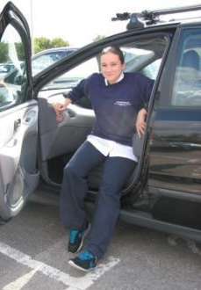
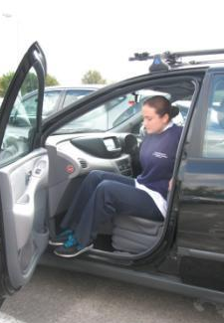
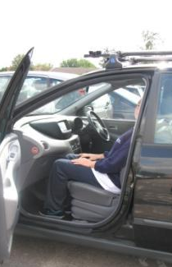
Getting in/out of a car (passenger)
Images © Biomet UK Ltd.
KNEE

Slide 8
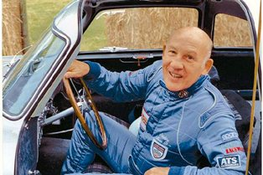
Driving
You will not be able to drive for 6 weeks after surgery.
Check that you are covered by your insurance company.

