Slide 1
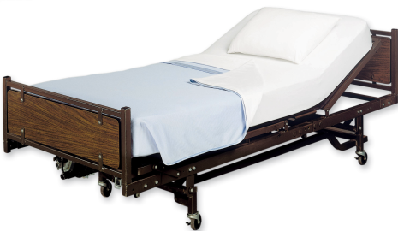
Your Hospital Stay
KNEE

Slide 2
Planning for your admission before you come in.
Bring all regular medication in original labelled containers (they will be returned prior to discharge) and ensure you have a supply of your regular medicines at home for your discharge.
Make arrangements for transport into hospital and for your return home.
Appropriate clothing and footwear and keep personal belongings to a minimum.
You are allowed light solids up to 6 hours before your surgery and you are clear fluids right up until you go to theatre.
Notes:
2

Slide 3
Admission to Hospital
You will normally be admitted to Station 16 at University of Ayr Hospital which is the elective Orthopaedic ward.
On arrival to ward you will be seen by a ward nurse who will do baseline observations and clarify all pre operative information
You will be seen by your Anaesthetist and Surgeon prior to your operation and your consent will be checked and your leg marked.
Further blood tests will be done
You will be encouraged to drink a glass of water an hour, right up until you go to theatre – this is called sip to send

Slide 4
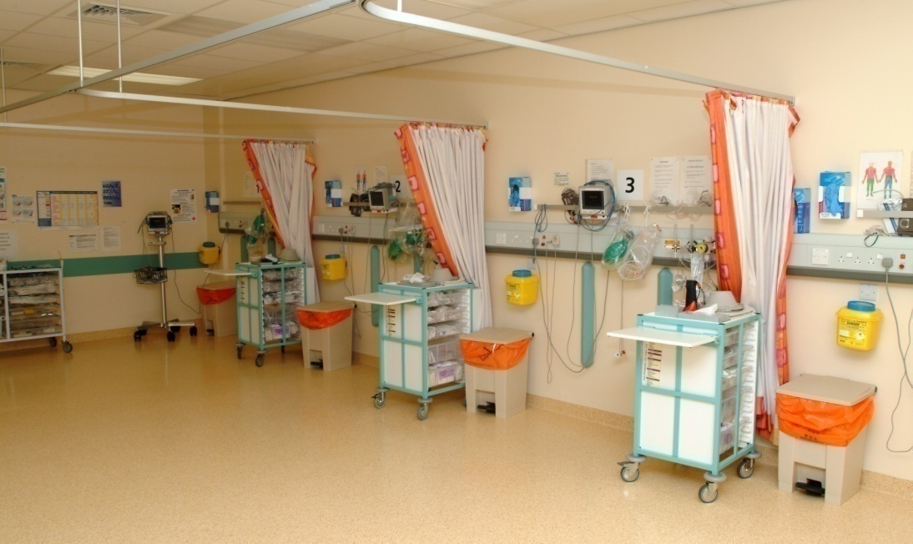
In the Recovery Room
You will spend the first hour or so after your operation in the Recovery Room where your bloods pressure, oxygen levels and pulse will be monitored.
The nurse will ensure your pain is under control, offer you a drink and ensure you are comfortable and you will return to the ward when it is safe to do so.
You may also have an oxygen mask
and a fluid drip.

Slide 5
Back on the ward
The nurse will carry out regular checks on your blood pressure, pulse, breathing and pain levels.
You will be encouraged to eat and drink.
You will be encouraged to start moving with the assistance of the physiotherapist or nursing staff and continue with your exercises independently.
Practice self-administration of anti-coagulant injection (if appropriate).

Slide 6
Your goals for discharge
We will work towards discharging you from hospital at the earliest point, as long as this is safe to do so. This may be as early as the day of your operation and will be guided by the physiotherapist, occupational therapist, nurses and doctor.
Depending on your abilities before surgery, your discharge goals are:
Being able to get dressed independently
Being able to get in/out of bed and on/off chair toilet independently
Mobilising well with walking aids and complete stairs where appropriate
Your pain is well controlled when doing exercises
There are no concerns with your wound

Slide 7
On Discharge
Wound checked prior to discharge
A check x-ray will be done prior to your discharge
Patient advised to make Practice Nurse appointment for removal of clips (where necessary)
Medication returned and Sharps box supplied for fragmin injection (if required)
Out patient appointment will be given for Arthroplasty Nurses.

