Slide 1
Total Hip Replacement

Slide 2
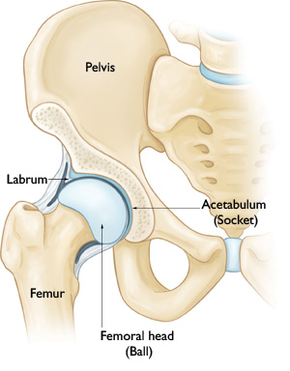
A Healthy Hip
The healthy hip joint has two smooth surfaces (cartilage) that slide smoothly over each other.
Smooth, healthy cartilage

Slide 3
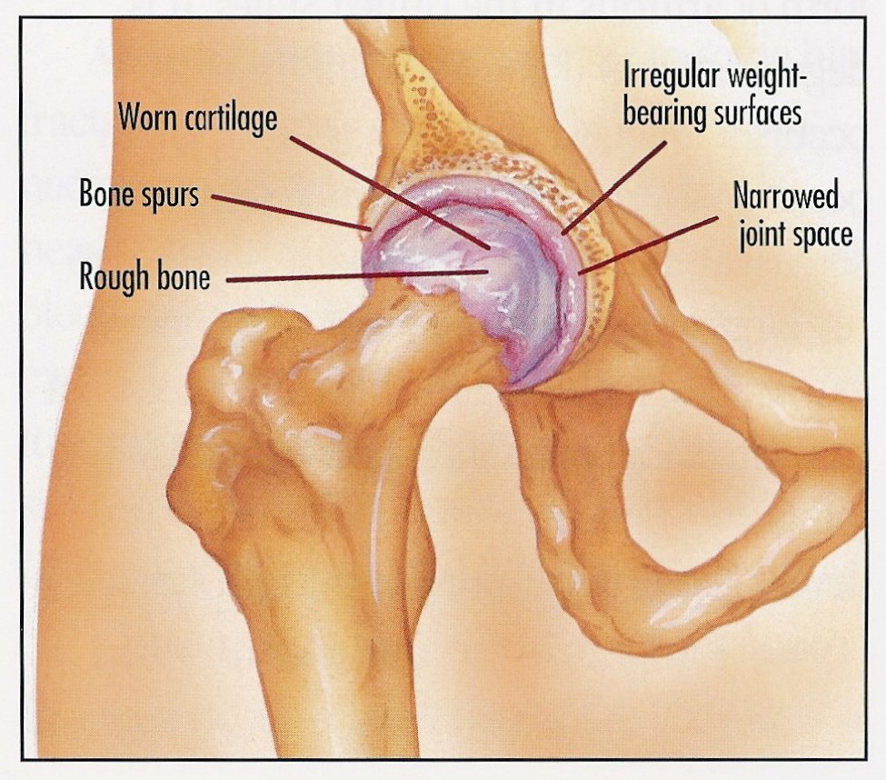
Osteoarthritis of the Hip
In Osteoarthritis the smooth cartilage wears away leaving rough surfaces that do not slide smoothly over each other.

Slide 4
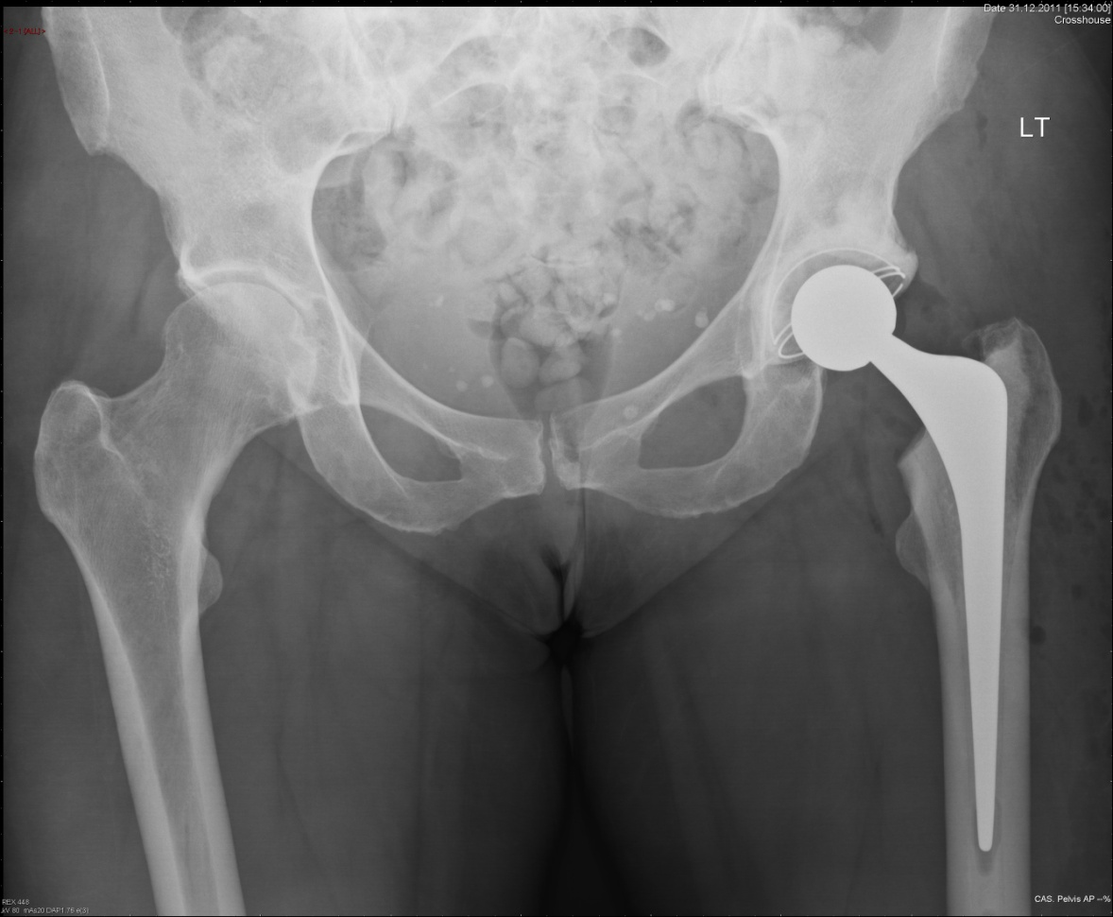
Total hip Replacement
A total hip replacement replaces the rough, worn surfaces with new, smooth artificial surfaces.

Slide 5
Other points………
Several surgeons undertake hip replacement surgery.
Are several different approaches to the hip.
This can affect the shape and position of your scar.
Length of scar is determined by the size of your leg and how complex the surgery might be.
All have excellent results.

Slide 6
Other points …
Many types of hip replacement on the market.
We DO NOT use metal on metal hip replacements.
All hip replacements used in Ayrshire and Arran have excellent long term clinical follow-up.
Your surgeon will discuss the approach and exact type of hip replacement with you prior to your operation.

Slide 8
Complications
Infection – 1% (1 in 100)

Slide 9
Complications
Infection – 1% (1 in 100)
Leg length discrepancy (different leg lengths)

Slide 10
Complications
Infection – 1% (1 in 100)
Leg length discrepancy (different leg lengths)
Dislocation – 1% (1 in 100)

Slide 11
Complications
Infection – 1% (1 in 100)
Leg length discrepancy (different leg lengths)
Dislocation – 1% (1 in 100)
Nerve injury – 0.2% (1 in 500)

Slide 12
Complications
Deep vein thrombosis (DVT or blood clot) – 1% (1 in 100)

Slide 13
Complications
Deep vein thrombosis (DVT or blood clot) – 1% (1 in 100)
Pulmonary embolism – 0.2% (1 in 500)

Slide 14
Complications
Deep vein thrombosis (DVT or blood clot) – 1% (1 in 100)
Pulmonary embolism – 0.2% (1 in 500)
Leg swelling – everyone

Slide 15
Complications
Chronic pain – problematic pain affects approx. 2% (1 in 50) of patients.

Slide 16
Complications
Chronic pain – problematic pain affects approx. 2% (1 in 50) of patients.
Fracture - 2% per 10 years. More likely in elderly patients.

Slide 17
Complications
Chronic pain – problematic pain affects approx. 2% (1 in 50) of patients.
Fracture - 2% per 10 years. More likely in elderly patients.
Loosening/wear – age dependant.

Slide 18
Complications
Chronic pain – problematic pain affects approx. 2% (1 in 50) of patients.
Fracture - 2% per 10 years. More likely in elderly patients.
Loosening/wear – age dependant.
Death – very very rare immediately following surgery.

Slide 19
What are the risks of my operation?
https://jointcalc.shef.ac.uk

Slide 20
https://jointcalc.shef.ac.uk

Slide 21
Will my symptoms improve?

Slide 22
Risk of further Surgery

Slide 23
Risk of Death

Slide 24
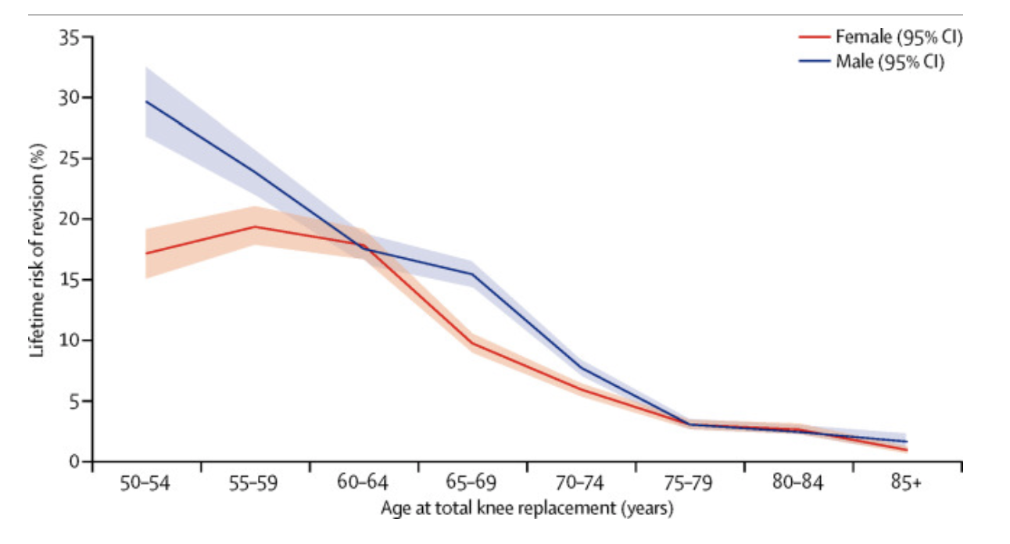
How long will my hip last last?

Slide 25
Further Questions?

